Slide 1
22
Cost-Volume-Profit
Learning Objectives
1
Explain variable, fixed, and mixed costs and the relevant range.
2
Apply the high-low method to determine the components of mixed costs.
3
Prepare a CVP income statement to determine contribution margin.
4
Compute the break-even point using three approaches.
5
Determine the sales required to earn target net income and determine margin of safety.
6
Use CVP analysis to respond to changes in the business environment.

Slide 2
LEARNING
OBJECTIVE
Explain variable, fixed, and mixed costs and the relevant range.
1
Cost Behavior Analysis is the study of how specific costs respond to changes in the level of business activity.
  Some costs change; others remain the same.
  Helps management plan operations and decide between alternative courses of action.
  Applies to all types of businesses and entities.
  Starting point is measuring key business activities.
LO 1

Slide 3
Cost Behavior Analysis
Cost Behavior Analysis is the study of how specific costs respond to changes in the level of business activity.
  Activity levels may be expressed in terms of:
    Sales dollars (in a retail company)
    Miles driven (in a trucking company)
    Room occupancy (in a hotel)
    Dance classes taught (by a dance studio)
  Many companies use more than one measurement base.
LO 1

Slide 4
Cost Behavior Analysis
Cost Behavior Analysis is the study of how specific costs respond to changes in the level of business activity.
  Changes in the level or volume of activity should be correlated with changes in costs.
  Activity level selected is called activity or volume index.
  Activity index:
    Identifies the activity that causes changes in the behavior of costs.
    Allows costs to be classified as variable, fixed, or mixed.
LO 1

Slide 5
Variable Costs
  Costs that vary in total directly and proportionately with changes in the activity level.
    Example: If the activity level increases 10 percent, total variable costs increase 10 percent.
    Example: If the activity level decreases by 25 percent, total variable costs decrease by 25 percent.
  Variable costs remain the same per unit at every level of activity.
LO 1

Slide 6
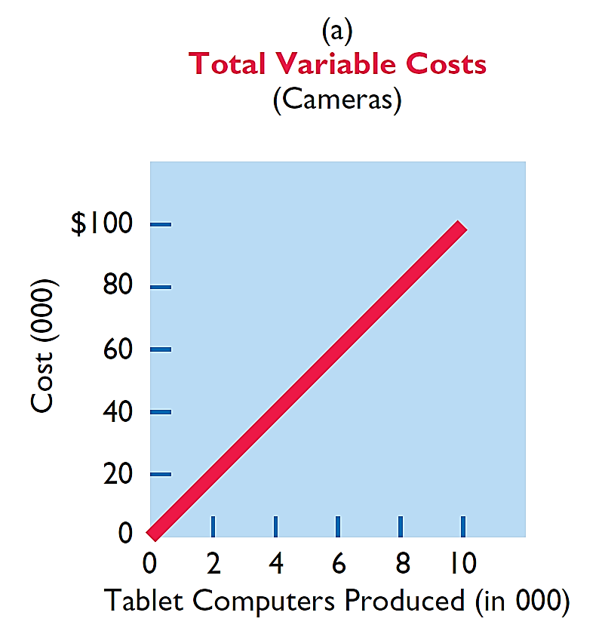
Variable Costs
Illustration: Damon Company manufactures tablet computers that contain a $10 camera. The activity index is the number of tablets
produced. As Damon manufactures each tablet, the total cost of the cameras used increases by $10. As part (a) of Illustration 22-1 shows, total cost of the cameras will be $20,000 if Damon produces 2,000 tablets, and $100,000 when it produces 10,000 tablets. We also can see that a variable cost remains the same per unit as the level of activity changes.
Illustration 22-1
LO 1

Slide 7
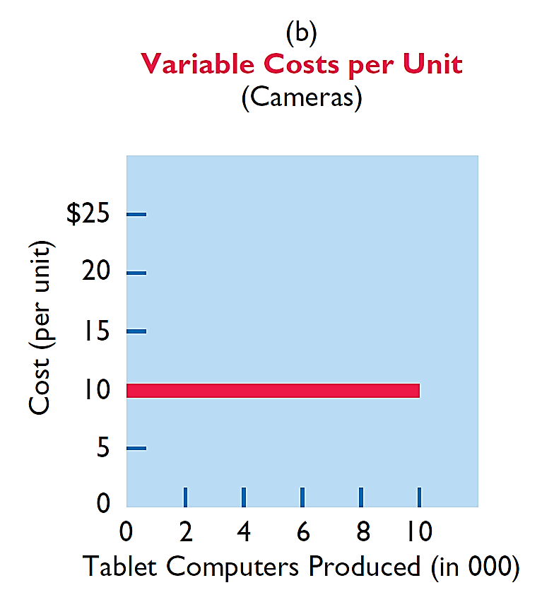
Variable Costs
Illustration: Damon Company manufactures tablet computers that contain a $10 camera. The activity index is the number of tablets
produced. As Damon manufactures each tablet, the total cost of the cameras used increases by $10. As part (b) of Illustration 22-1 shows, the unit cost of $10 for the camera is the same whether Damon produces 2,000 or 10,000 tablets.
Illustration 22-1
LO 1

Slide 8
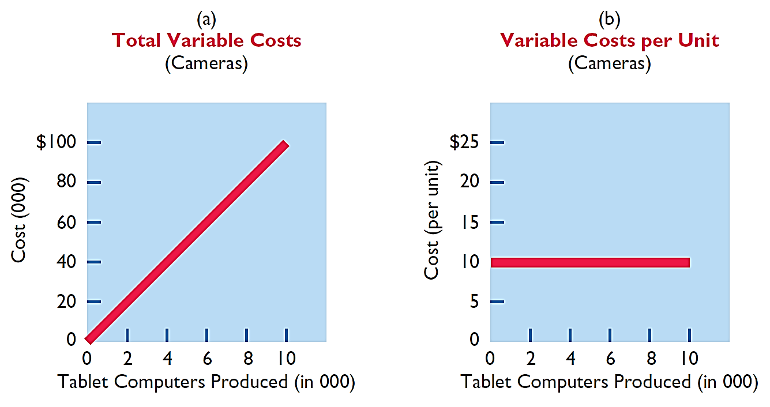
Variable Costs
Illustration 22-1
Behavior of total and unit variable costs
LO 1

Slide 9
Variable Costs
Question
Variable costs are costs that:
a. Vary in total directly and proportionately with changes in the activity level.
b. Remain the same per unit at every activity level.
c. Neither of the above.
d. Both (a) and (b) above.
LO 1

Slide 10
Fixed Costs
  Costs that remain the same in total regardless of changes in the activity level within a relevant range.
  Fixed cost per unit cost varies inversely with activity: As volume increases, unit cost declines, and vice versa
  Examples:
    Property taxes
    Insurance
    Rent
    Depreciation on buildings and equipment
LO 1

Slide 11
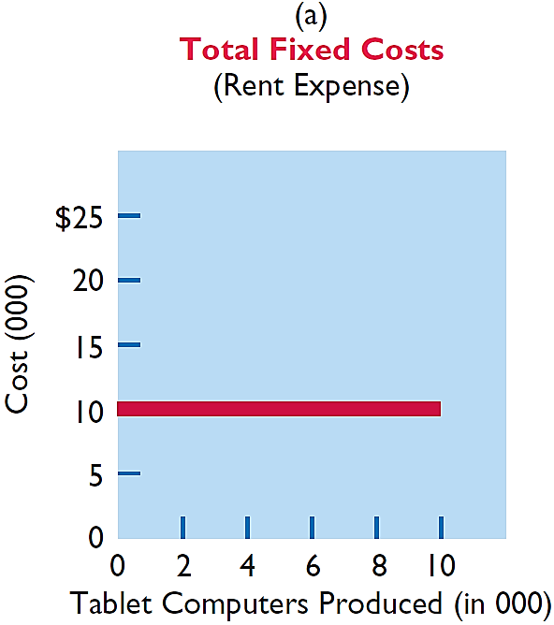
Fixed Costs
Illustration: Damon Company leases its productive facilities at a cost of $10,000 per month. Total fixed costs of the facilities will remain
constant at every level of activity, as part (a) of Illustration 22-2 shows.
Illustration 22-2
LO 1

Slide 12
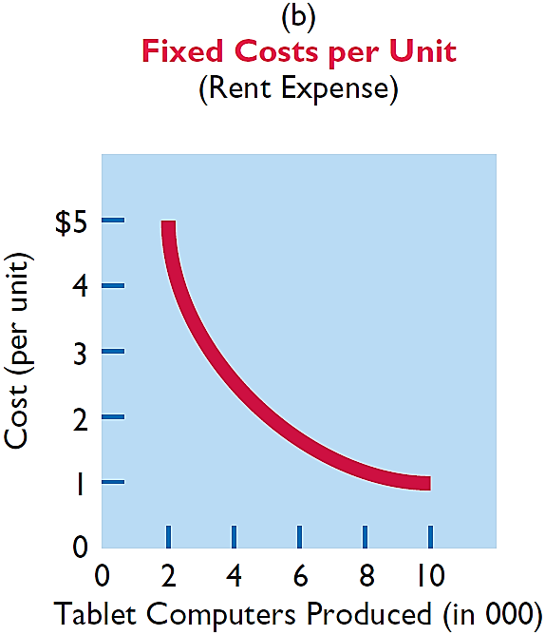
Fixed Costs
Illustration: Damon Company leases its productive facilities at a cost of $10,000 per month. Total fixed costs of the facilities will remain
constant at every level of activity. But, on a per unit basis, the cost of rent will decline as activity increases, as part (b) of Illustration 22-2 shows. At 2,000 units, the unit cost per tablet computer is $5 ($10,000 ÷ 2,000). When Damon produces 10,000 tablets, the unit cost of the rent is only $1 per tablet ($10,000 ÷ 10,000).
Illustration 22-2
LO 1

Slide 13
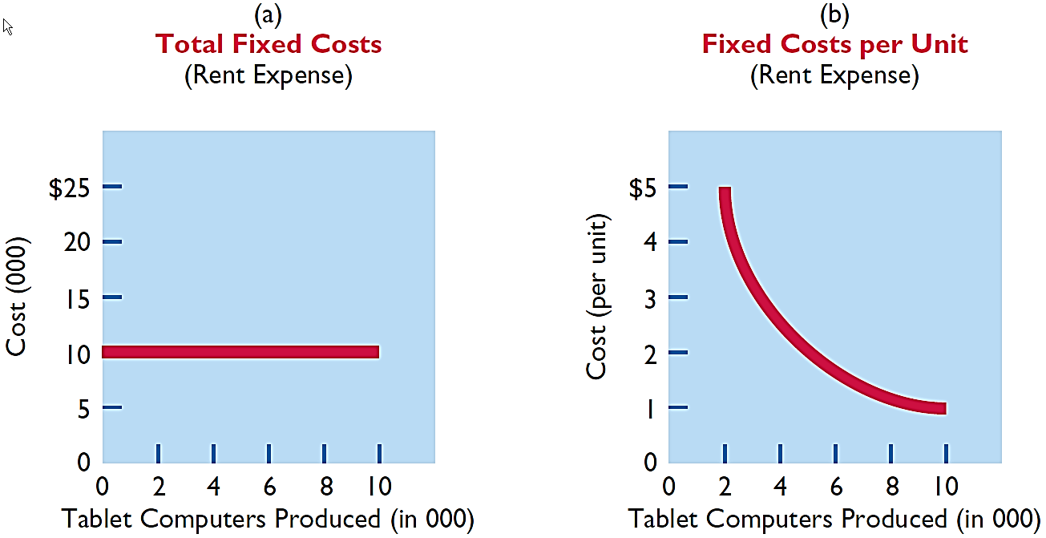
Fixed Costs
Illustration 22-2
Behavior of total and unit fixed costs
LO 1

Slide 14
People, Planet, and Profit Insight
Gardens in the Sky
Because of population increases, the United Nations’ Food and Agriculture Organization estimates that food production will need to increase by 70% by 2050. Also, by 2050, roughly 70% of people will live in cities, which means more food needs to be hauled further to get it to the consumer. To address the lack of farmable land and reduce the cost of transporting produce, some companies, such as New York-based Bright Farms, are building urban greenhouses. This sounds great, but do the numbers work? Some variable costs would be reduced. For example, the use of pesticides, herbicides, fuel costs for shipping, and water would all drop. Soil erosion would be a non-issue since plants would be grown hydroponically (in a solution of water and minerals), and land requirements would be reduced because of vertical structures. But, other costs would be higher. First, there is the cost of the building. Also, any multistory building would require artificial lighting for plants on lower floors. Until these cost challenges can be overcome, it appears that these urban greenhouses may not break even. On the other hand, rooftop greenhouses on existing city structures already appear financially viable. For example, a 15,000 square-foot rooftop greenhouse in Brooklyn already produces roughly 30 tons of vegetables per year for local residents.
Sources: “Vertical Farming: Does It Really Stack Up?” The Economist (December 9, 2010); and Jane Black, “Bright Farms Idea: Greenhouses That Cut Short the Path from Plant to Grocery Shelf,” The Washington Post (May 7, 2013).
LO 1

Slide 15
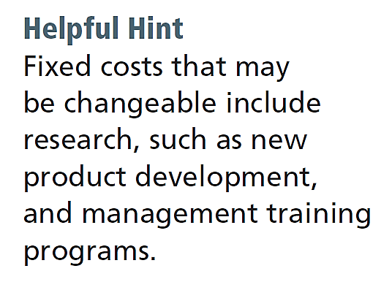
Relevant Range
  Throughout the range of possible levels of activity, a straight-line relationship usually does not exist for either variable costs or fixed costs.
  Relationship between variable costs and changes in activity level is often curvilinear.
  For fixed costs, the relationship is also nonlinear – some fixed costs will not change over the entire range of activities, while other fixed costs may change.
LO 1

Slide 16
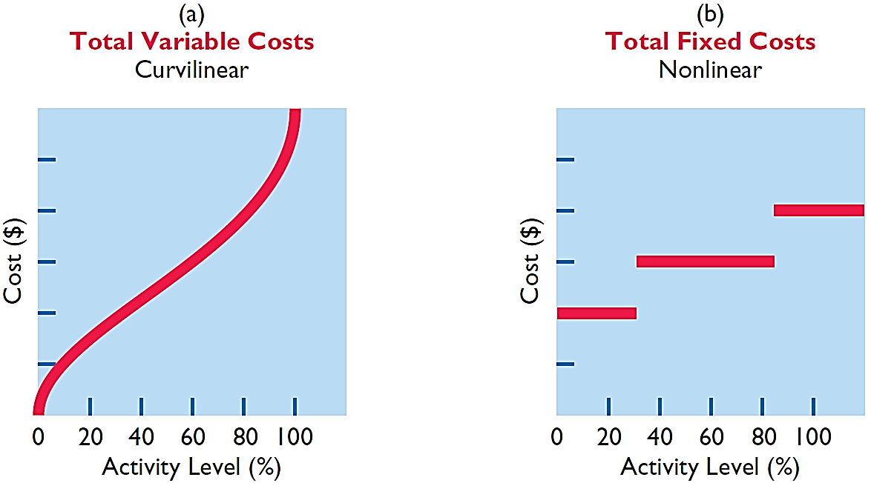
Relevant Range
Illustration 22-3
Nonlinear behavior of variable and fixed costs
LO 1

Slide 17
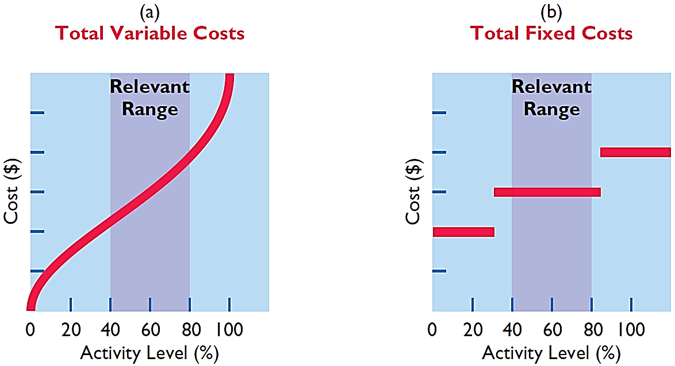
Relevant Range
Range of activity over which a company expects to operate during a year.
Illustration 22-4
Linear behavior within relevant range
LO 1

Slide 18
Relevant Range
Question
The relevant range is:
The range of activity in which variable costs will be curvilinear.
The range of activity in which fixed costs will be curvilinear.
The range over which the company expects to operate during a year.
Usually from zero to 100% of operating capacity.
LO 1

Slide 19
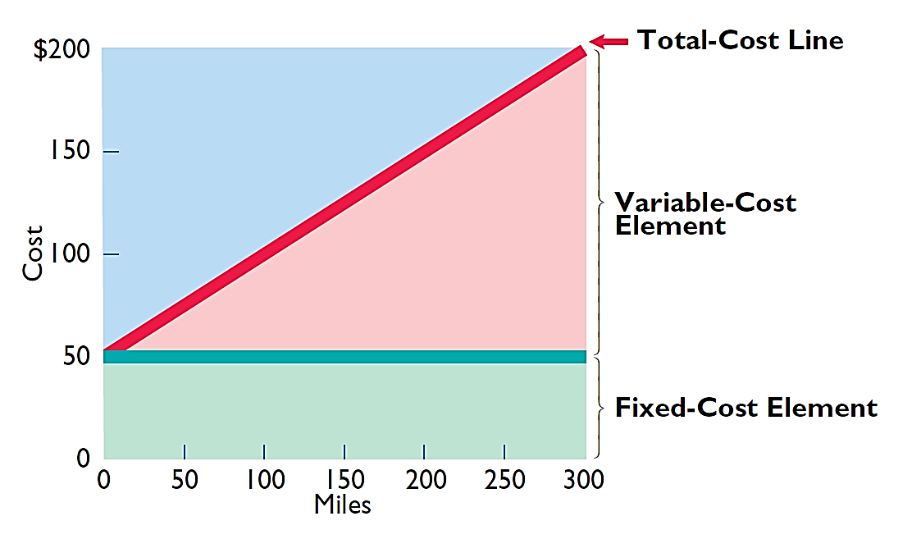
Mixed Costs
  Costs that have both a variable element and a fixed element.
  Change in total but not proportionately with changes in activity level.
Illustration 22-5
Behavior of a mixed cost
LO 1

Slide 20
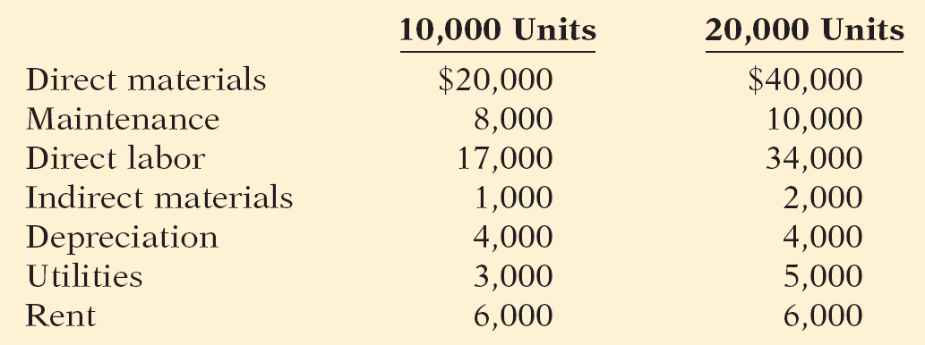
DO IT!
1
Type of Costs
Helena Company, reports the following total costs at two levels of production.
Classify each cost as variable, fixed, or mixed.
Variable
Fixed
Mixed
LO 1

Slide 21
LEARNING
OBJECTIVE
Apply the high-low method to determine the components of mixed costs.
2
High-Low Method
  High-Low Method uses the total costs incurred at the high and the low levels of activity to classify mixed costs into fixed and variable components.
  The difference in costs between the high and low levels represents variable costs, since only variable-cost element can change as activity levels change.
LO 2

Slide 22
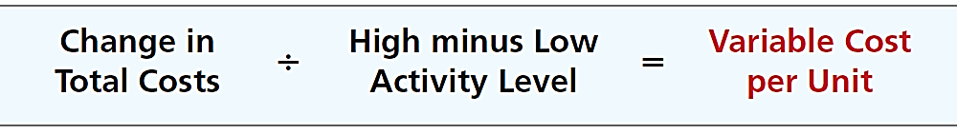
High-Low Method
  STEP 1: Determine variable cost per unit using the following formula:
Illustration 22-6
Formula for variable cost per
unit using high-low method
LO 2

Slide 23
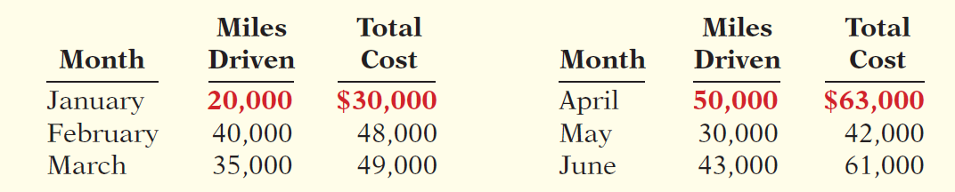
High-Low Method
Illustration: Metro Transit Company has the following maintenance costs and mileage data for its fleet of buses over a 6-month period.
Illustration 22-7
Assumed maintenance costs and mileage data
Change in Costs
(63,000 - 30,000) $33,000
=
$1.10
High minus Low
(50,000 - 20,000) 30,000
cost per unit
LO 2

Slide 24
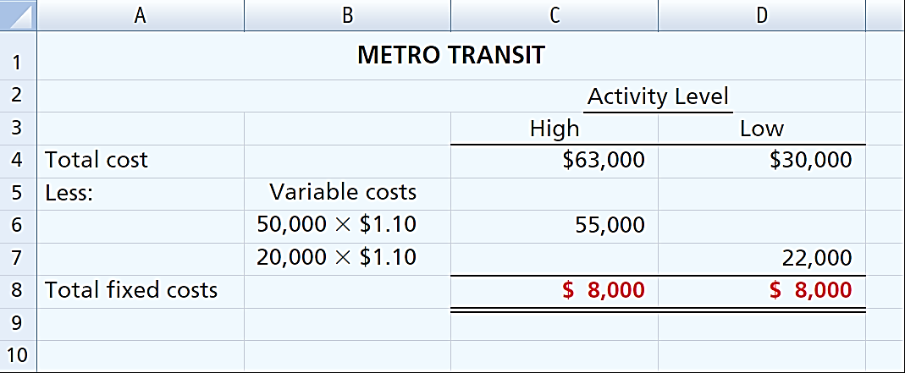
High-Low Method
STEP 2: Determine the fixed cost by subtracting the total variable cost at either the high or the low activity level from the total cost at that activity level.
Illustration 22-8
High-low method computation of fixed costs
LO 2

Slide 25
High-Low Method
Maintenance costs are therefore $8,000 per month of fixed costs plus $1.10 per mile of variable costs. This is represented by the following formula:
Maintenance costs = $8,000 + ($1.10 x Miles driven)
Example: At 45,000 miles, estimated maintenance costs would be:
Fixed
$ 8,000
Variable
($1.10 x 45,000) 49,500
$57,500
LO 2

Slide 26
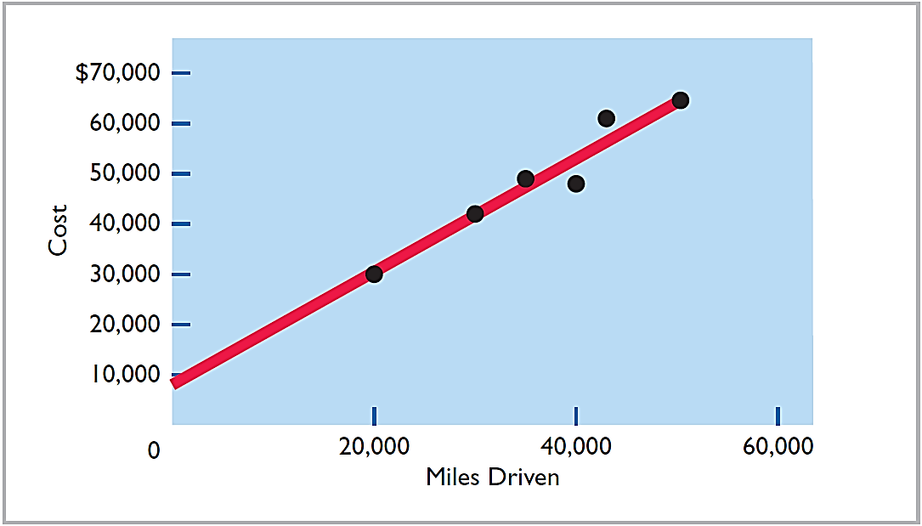
High-Low Method
Illustration 22-9
Scatter plot for Metro Transit Company
LO 2

Slide 27
High-Low Method
Question
Mixed costs consist of a:
Variable cost element and a fixed cost element.
Fixed cost element and a controllable cost element.
Relevant cost element and a controllable cost element.
Variable cost element and a relevant cost element.
LO 2

Slide 28
Management Insight
Temper Sealy International
Skilled Labor Is Truly Essential
The recent recession had devastating implications for employment. But one surprise was that for some manufacturers, the number of jobs lost was actually lower than in previous recessions. One of the main explanations for this was that in the years preceding the recession, many companies, such as Tempur Sealy International, adopted lean manufacturing practices. This meant that production relied less on large numbers of low-skilled workers and more on machines and a few highly skilled workers. As a result of this approach, a single employee supports far more dollars in sales. Thus, it requires a larger decline in sales before an employee would need to be laid-off in order for the company to continue to break even. Also, because the employees are highly skilled, employers are reluctant to lose them. Instead of lay-offs, many manufacturers now resort to cutting employees’ hours when necessary.
Source: Timothy Aeppel and Justin Lahart, “Lean Factories Find It Hard to Cut Jobs Even in a Slump,” Wall Street Journal Online (March 9, 2009).
LO 2

Slide 29
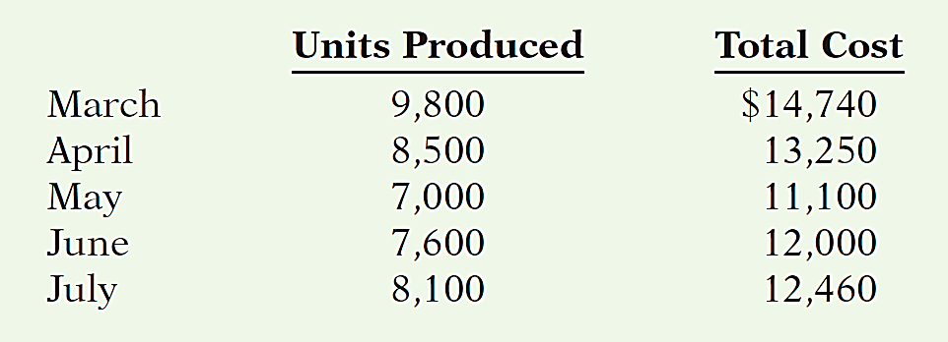
DO IT!
2
High-Low Method
Byrnes Company accumulates the following data concerning a mixed cost, using units produced as the activity level.
Compute the variable- and fixed-cost elements using the high-low method.
Estimate the total cost if the company produces 8,000 units.
LO 2

Slide 30
DO IT!
2
High-Low Method
Compute the variable and fixed cost elements using the high-low method.
Variable cost: ($14,740 - $11,100) / (9,800 - 7,000) = $1.30 per unit
Fixed cost: $14,740 - $12,740 ($1.30 x 9,800 units) = $2,000
or $11,100 - $9,100 ($1.30 x 7,000) = $2,000
LO 2

Slide 31
DO IT!
2
High-Low Method
Estimate the total cost if the company produces 8,000 units.
Total cost (8,000 units): $2,000 + $10,400 ($1.30 x 8,000) = $12,400
LO 2

Slide 32
LEARNING
OBJECTIVE
Prepare a CVP income statement to determine contribution margin.
3
Cost-volume-profit (CVP) analysis is the study of the effects of changes in costs and volume on a company’s profits.
  Important in profit planning.
  Critical factor in management decisions as
    Setting selling prices,
    Determining product mix, and
    Maximizing use of production facilities.
LO 3

Slide 33

Cost-Volume-Profit Analysis
Basic Components
Illustration 22-10
Components of CVP analysis
LO 3

Slide 34
Basic Components
Assumptions
  Behavior of both costs and revenues is linear throughout the relevant range of the activity index.
  Costs can be classified accurately as either variable or fixed.
  Changes in activity are the only factors that affect costs.
  All units produced are sold.
  When more than one type of product is sold, the sales mix will remain constant.
LO 3

Slide 35
Basic Components
Question
Which of the following is not involved in CVP analysis?
Sales mix.
Unit selling prices.
Fixed costs per unit.
Volume or level of activity.
LO 3

Slide 36
Cost-Volume-Profit Analysis
CVP Income Statement
  A statement for internal use.
  Classifies costs and expenses as fixed or variable.
  Reports contribution margin in the body of the statement.
    Contribution margin – amount of revenue remaining after deducting variable costs.
  Reports the same net income as a traditional income statement.
LO 3

Slide 37
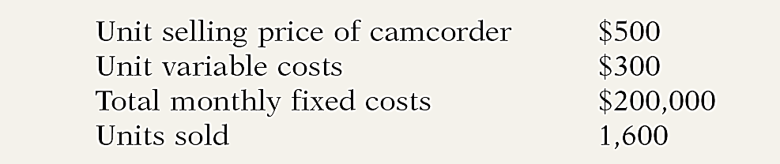
CVP Income Statement
Illustration: Vargo Video Company produces a high-definition digital camcorder. Relevant data for the camcorders sold by this company in June 2014 are as follows.
Illustration 22-11
Assumed selling and cost data
for Vargo Video
LO 3

Slide 38
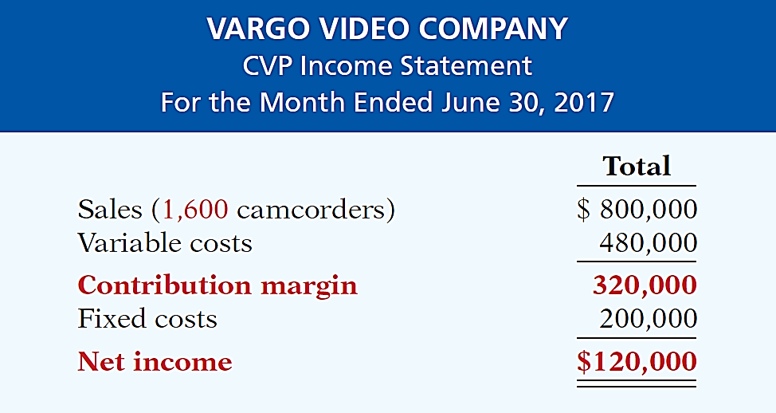
CVP Income Statement
Illustration: The CVP income statement for Vargo Video therefore would be reported as follows.
Illustration 22-12
LO 3

Slide 39
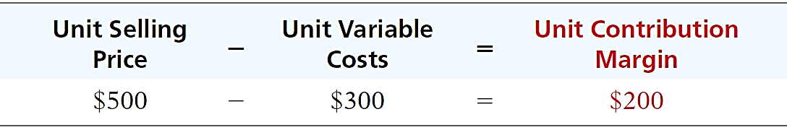
CVP Income Statement
UNIT CONTRIBUTION MARGIN
  Contribution margin is available to cover fixed costs and to contribute to income.
  Formula for contribution margin per unit and the computation for Vargo Video are:
Illustration 22-13
Formula for unit contribution margin
LO 3

Slide 40
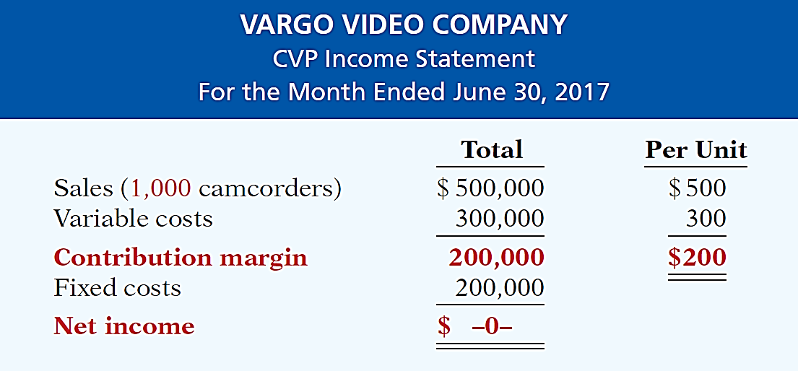
CVP Income Statement
UNIT CONTRIBUTION MARGIN
Vargo’s CVP income statement assuming a zero net income.
Illustration 22-14
LO 3

Slide 41
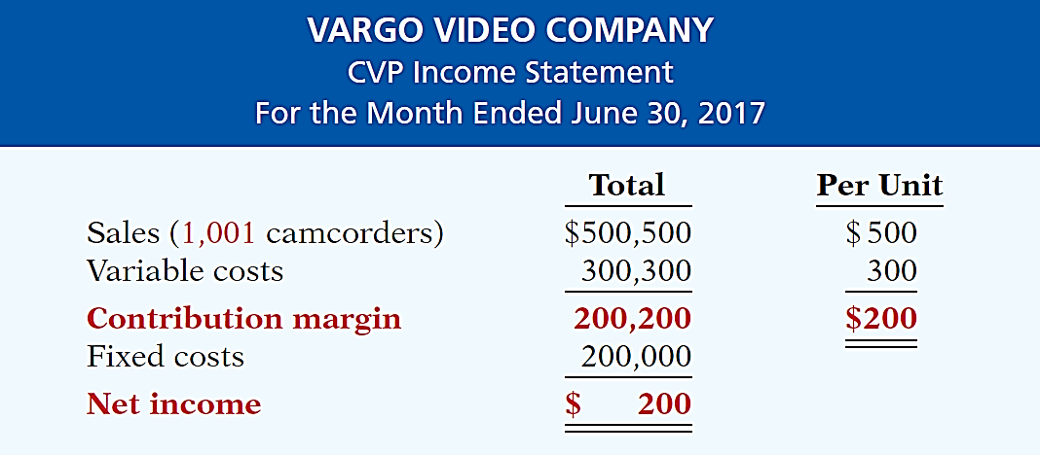
CVP Income Statement
UNIT CONTRIBUTION MARGIN
Assume that Vargo sold one more camcorder, for a total of 1,001 camcorders sold.
Illustration 22-15
LO 3

Slide 42
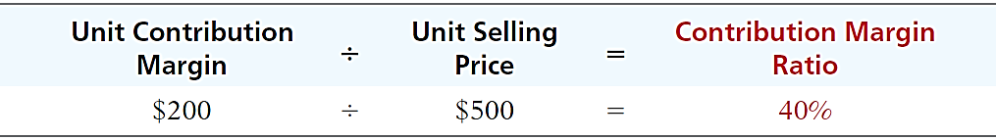
CVP Income Statement
CONTRIBUTION MARGIN RATIO
  Shows the percentage of each sales dollar available to apply toward fixed costs and profits.
  Formula for contribution margin ratio and the computation for Vargo Video are:
Illustration 22-17
Formula for contribution
margin ratio
LO 3

Slide 43
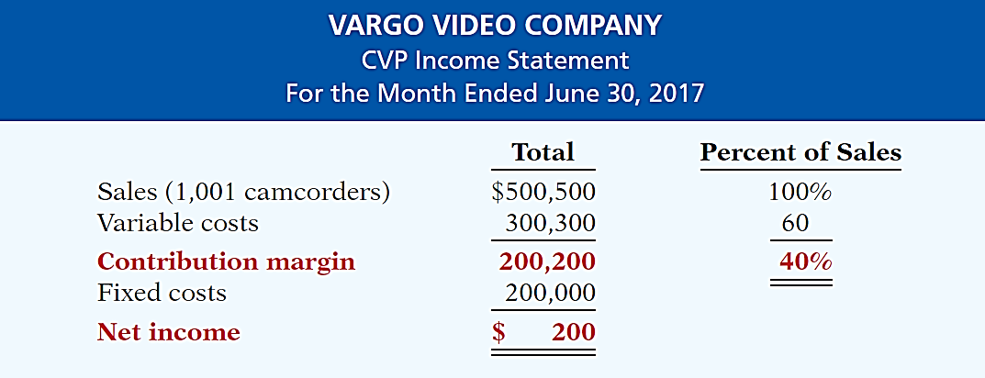
CVP Income Statement
CONTRIBUTION MARGIN RATIO
Illustration 22-16
CVP income statement, with
net income and percent of sales data
LO 3

Slide 44
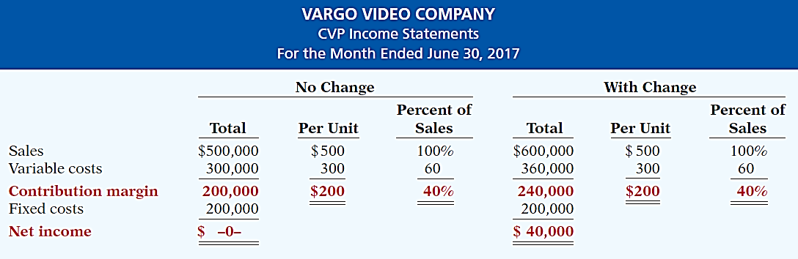
CVP Income Statement
CONTRIBUTION MARGIN RATIO
Assume Vargo Video’s current sales are $500,000 and it wants to know the effect of a $100,000 (200-unit) increase in sales.
Illustration 22-18
LO 3

Slide 45
CVP Income Statement
Question
Contribution margin:
a. Is revenue remaining after deducting variable costs.
b. May be expressed as contribution margin per unit.
c. Is selling price less cost of goods sold.
d. Both (a) and (b) above.
LO 3

Slide 46
DO IT!
3
CVP Income Statement
Ampco Industries produces and sells a cell phone-operated thermostat. Information regarding the costs and sales of thermostats during September 2017 are provided below.
Unit selling price of thermostat $85
Unit variable costs $32
Total monthly fixed costs $190,000
Units sold 4,000
Prepare a CVP income statement for Ampco Industries for the month of September. Provide per unit values and total values.
LO 3

Slide 47
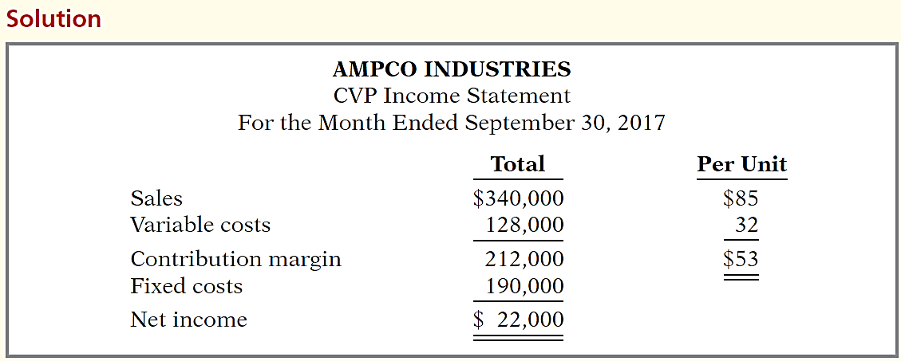
DO IT!
3
CVP Income Statement
Prepare a CVP income statement for Ampco Industries for the month of September. Provide per unit values and total values.
LO 3

Slide 48
LEARNING
OBJECTIVE
Compute the break-even point using three approaches.
4
Break-Even Analysis
Process of finding the break-even point level of activity at which total revenues equal total costs (both fixed and variable).
Can be computed or derived
  from a mathematical equation,
  by using contribution margin, or
  from a cost-volume profit (CVP) graph.
Expressed either in sales units or in sales dollars.
LO 4

Slide 49
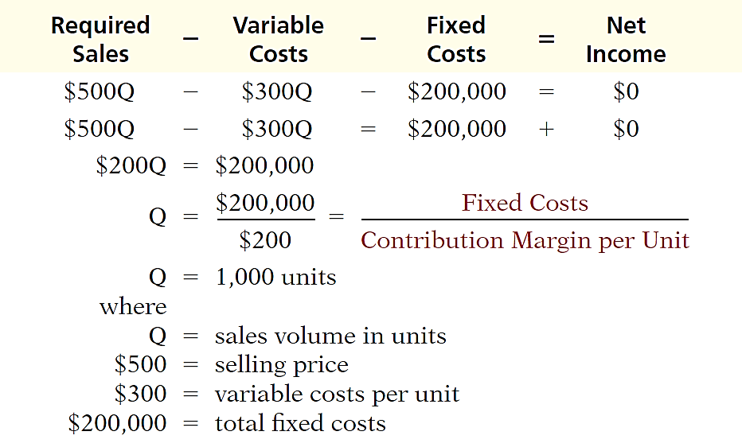
Mathematical Equation
Break-even occurs where total sales equal variable costs plus fixed costs; i.e., net income is zero
Computation of break-even point in units.
Illustration 22-20
LO 4

Slide 50
Contribution Margin Technique
  At the break-even point, contribution margin must equal total fixed costs
(CM = total revenues – variable costs)
  Break-even point can be computed using either contribution margin per unit or contribution margin ratio.
LO 4

Slide 51
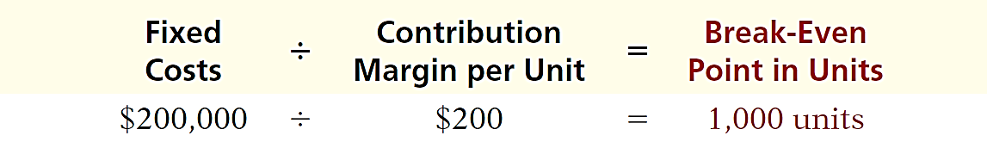
Contribution Margin Technique
CONTRIBUTION MARGIN IN UNITS
  When the break-even-point in units is desired, contribution margin per unit is used in the following formula which shows the computation for Vargo Video:
Illustration 22-21
Formula for break-even point
in units using unit contribution
margin
LO 4

Slide 52
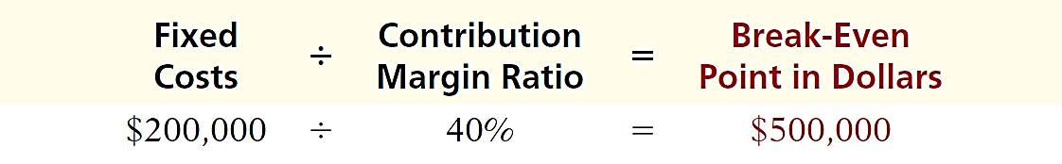
Contribution Margin Technique
CONTRIBUTION MARGIN RATIO
  When the break-even-point in dollars is desired, contribution margin ratio is used in the following formula which shows the computation for Vargo Video:
Illustration 22-22
Formula for break-even point
in dollars using contribution
Margin ratio
LO 4

Slide 53
Service Company Insight
Flightserve
Charter Flights Offer a Good Deal
The Internet is wringing inefficiencies out of nearly every industry. While commercial aircraft spend roughly 4,000 hours a year in the air, chartered aircraft are flown only 500 hours annually. That means that they are sitting on the ground—not making any money—about 90% of the time. One company, Flightserve, saw a business opportunity in that fact. For about the same cost as a first-class ticket, Flightserve matches up executives with charter flights in small “private jets.” The executive gets a more comfortable ride and avoids the hassle of big airports. Flightserve noted that the average charter jet has eight seats. When all eight seats are full, the company has an 80% profit margin. It breaks even at an average of 3.3 full seats per flight.
Source: “Jet Set Go,” The Economist (March 18, 2000), p. 68.
LO 4

Slide 54
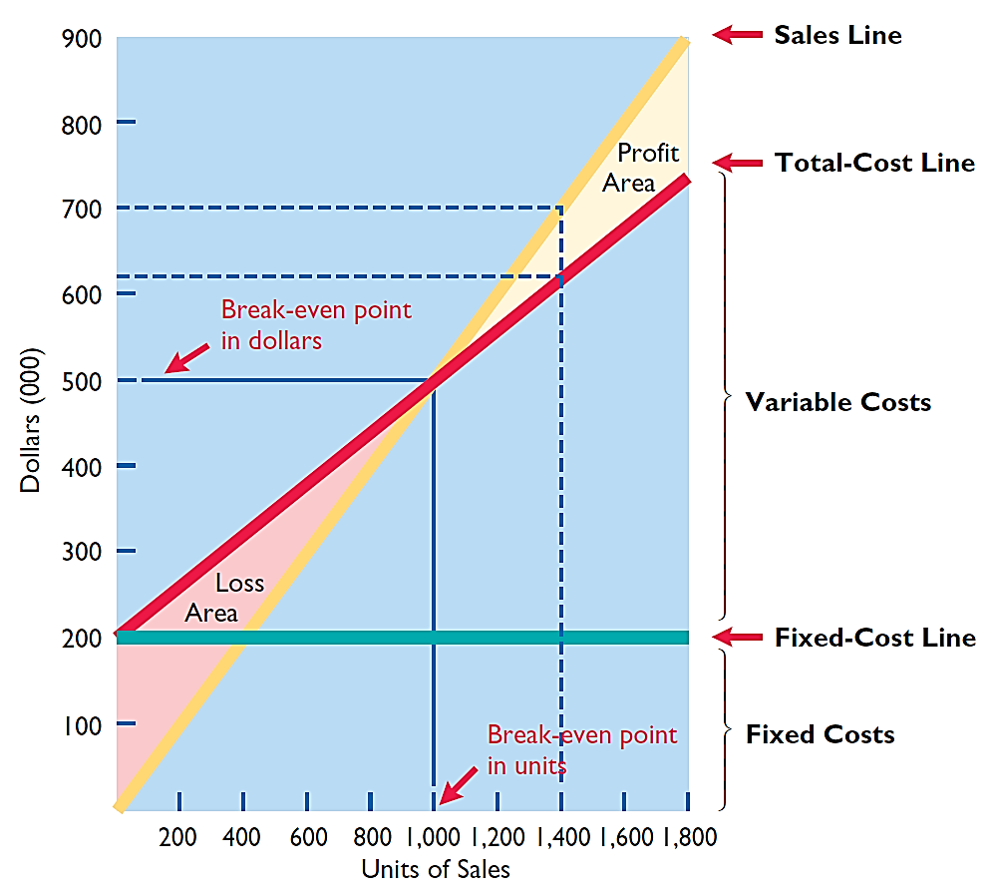
Graphic Presentation
Because this graph also shows costs, volume, and profits, it is referred to as a cost-volume-profit (CVP) graph.
Illustration 22-23
CVP graph
LO 4

Slide 55
Break-Even Analysis
Question
Gossen Company is planning to sell 200,000 pliers for $4 per unit. The contribution margin ratio is 25%. If Gossen will break even at this level of sales, what are the fixed costs?
$100,000.
$160,000.
$200,000.
$300,000.
LO 4

Slide 56
DO IT!
4
Break-Even Analysis
Lombardi Company has a unit selling price of $400, variable costs per unit of $240, and fixed costs of $180,000. Compute the break-even point in units using (a) a mathematical equation and (b) contribution margin per unit.
Variable Costs
Fixed Costs
Net Income
Sales
-
-
=
$400Q
-
$240Q
-
$180,000
=
0
$160Q
-
$180,000
Q
=
1,125 units
LO 4

Slide 57
DO IT!
4
Break-Even Analysis
Lombardi Company has a unit selling price of $400, variable costs per unit of $240, and fixed costs of $180,000. Compute the break-even point in units using (a) a mathematical equation and (b) contribution margin per unit.
Fixed Costs
Contribution Margin per Unit
Break-Even Point in Units
÷
=
$180,000
÷
$160
=
1,125 units
LO 4

Slide 58
LEARNING
OBJECTIVE
Determine the sales required to earn target net income and determine margin of safety.
5
Target Net Income
  Level of sales necessary to achieve a specified income.
  Can be determined from each of the approaches used to determine break-even sales/units:
    from a mathematical equation,
    by using contribution margin technique, or
    from a cost-volume profit (CVP) graph.
  Expressed either in sales units or in sales dollars.
LO 5

Slide 59

Target Net Income
MATHEMATICAL EQUATION
Formula for required sales to meet target net income.
Illustration 22-24
LO 5

Slide 60
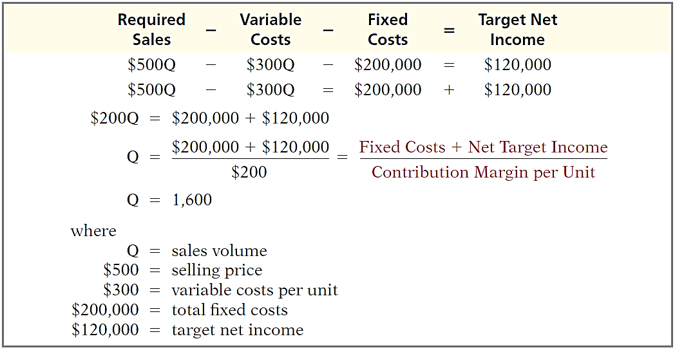
Target Net Income
MATHEMATICAL EQUATION
Using the formula for the break-even point, simply include the desired net income as a factor.
Illustration 22-25
LO 5

Slide 61
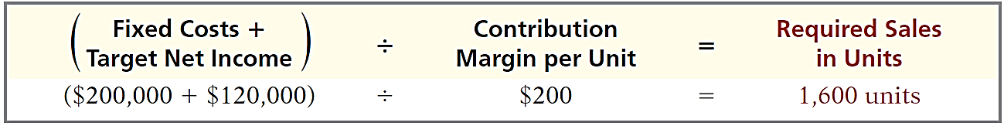
Target Net Income
CONTRIBUTION MARGIN TECHNIQUE
To determine the required sales in units for Vargo Video:
Illustration 22-26
Formula for required sales in
units using unit contribution
margin
LO 5

Slide 62
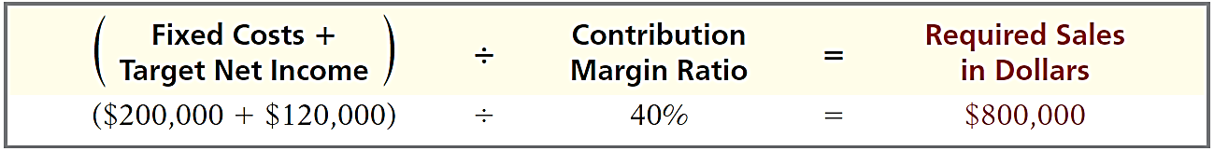
Target Net Income
CONTRIBUTION MARGIN TECHNIQUE
To determine the required sales in dollars for Vargo Video:
Illustration 22-27
Formula for required sales
in dollars using contribution
margin ratio
LO 5

Slide 63
Target Net Income
GRAPHIC PRESENTATION
Suppose Vargo Video sells 1,400 camcorders. Illustration 22-23 shows that a vertical line drawn at 1,400 units intersects the sales line at $700,000 and the total cost line at $620,000. The difference between the two amounts represents the net income (profit) of $80,000.
Illustration 22-23
LO 5

Slide 64
Target Net Income
Question
The mathematical equation for computing required sales to obtain target net income is:
Required sales =
Variable costs + Target net income.
Variable costs + Fixed costs + Target net income.
Fixed costs + Target net income.
No correct answer is given.
LO 5

Slide 65
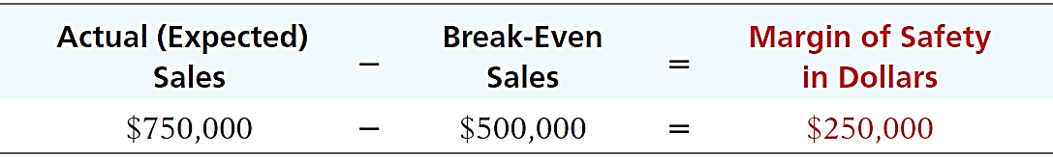
Margin of Safety
  Difference between actual or expected sales and sales at the break-even point.
  Measures the “cushion” that a particular level of sales provides.
  May be expressed in dollars or as a ratio.
  Assuming actual/expected sales are $750,000:
Illustration 22-28
Formula for margin of safety
in dollars
LO 5

Slide 66
Margin of Safety
  Computed by dividing the margin of safety in dollars by the actual (or expected) sales.
  Assuming actual/expected sales are $750,000:
Illustration 22-29
  The higher the dollars or percentage, the greater the margin of safety.
LO 5

Slide 67
Margin of Safety
Question
Marshall Company had actual sales of $600,000 when break-even sales were $420,000. What is the margin of safety ratio?
25%.
30%.
33 1/3%.
45%.
LO 5

Slide 68
Service Company Insight
Rolling Stones
How a Rolling Stones’ Tour Makes Money
Computations of break-even and margin of safety are important for service companies. Consider how the promoter for the Rolling Stones’ tour used the break-even point and margin of safety. For example, say one outdoor show should bring 70,000 individuals for a gross of $2.45 million. The promoter guarantees $1.2 million to the Rolling Stones. In addition, 20% of gross goes to the stadium in which the performance is staged. Add another$400,000 for other expenses such as ticket takers, parking attendants, advertising, and so on. The promoter also shares in sales of T-shirts and memorabilia for which the promoter will net over $7 million during the tour. From a successful Rolling Stones’ tour, the promoter could make $35 million!
LO 5

Slide 69
DO IT!
Break-Even, Margin of
Safety, and Target Net Income
5
Comprehensive
  Zootsuit Inc. makes travel bags that sell for $56 each. For the coming year, management expects fixed costs to total $320,000 and variable costs to be $42 per unit. Compute the following:
  break-even point in dollars using the contribution margin (CM) ratio;
  the margin of safety and margin of safety ratio assuming actual sales are $1,382,400; and
  the sales dollars required to earn net income of $410,000.
LO 5

Slide 70
DO IT!
Break-Even, Margin of
Safety, and Target Net Income
5
  Zootsuit Inc. makes travel bags that sell for $56 each. For the coming year, management expects fixed costs to total $320,000 and variable costs to be $42 per unit. Compute break-even point in dollars using the contribution margin (CM) ratio.
Contribution margin ratio = [($56 - $42) ÷ $56] = 25%
Break-even sales in dollars = $320,000 ÷ 25% = $1,280,000
LO 5

Slide 71
DO IT!
Break-Even, Margin of
Safety, and Target Net Income
5
  Zootsuit Inc. makes travel bags that sell for $56 each. For the coming year, management expects fixed costs to total $320,000 and variable costs to be $42 per unit. Compute the margin of safety and margin of safety ratio assuming actual sales are $1,382,400.
Margin of safety = $1,382,400 - $1,280,000 = $102,400
Margin of safety ratio = $102,400 ÷ $1,382,400 = 7.4%
LO 5

Slide 72
DO IT!
Break-Even, Margin of
Safety, and Target Net Income
5
  Zootsuit Inc. makes travel bags that sell for $56 each. For the coming year, management expects fixed costs to total $320,000 and variable costs to be $42 per unit. Compute the sales dollars required to earn net income of $410,000.
Required sales in dollars =
($320,000 + $410,000) ÷ 25% = $2,920,000
LO 5

Slide 73
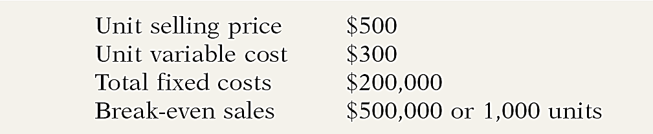
LEARNING
OBJECTIVE
Use CVP analysis to respond to changes in the business environment.
6
Illustration: Three independent situations that might occur at Vargo Video. Each case uses the original camcorder sales and cost data, which were as follows.
Illustration 22-30
Original camcorder sales
and cost data
LO 6

Slide 74
Case I: Offering a Discount
A competitor is offering a 10% discount on the selling price of its camcorders. Management must decide whether to offer a similar discount.
Question: What effect will a 10% discount on selling price ($500 x 10% = $50) have on the breakeven point?
Fixed Costs
÷
Unit Contribution Margin
=
Break-Even Sales
$200,000
÷
$150
=
1,333 units (rounded)
Illustration 22-31
Computation of break-even sales in units
LO 6

Slide 75
Case II: Investing in New Equipment
Management invests in new robotic equipment that will lower the amount of direct labor required to make camcorders. Estimates are that total fixed costs will increase 30% and that variable cost per unit will decrease 30%.
Question: What effect will the new equipment have on the sales volume required to break even?
Fixed Costs
÷
Unit Contribution Margin
=
Break-Even Sales
$260,000
÷
($500 - $210)
=
897 units (rounded)
Illustration 22-32
Computation of break-even sales in units
LO 6

Slide 76
Case III: Determining Required Sales
Vargo’s principal supplier of raw materials has just announced a price increase. The higher cost is expected to increase the variable cost of camcorders by $25 per unit. Management decides to hold the line on the selling price of the camcorders. It plans a cost-cutting program that will save $17,500 in fixed costs per month. Vargo is currently realizing monthly net income of $80,000 on sales of 1,400 camcorders.
Question: What increase in units sold will be needed to maintain the same level of net income?
LO 6

Slide 77
Case III: Determining Required Sales
Variable cost per unit increases to $325 ($300 + $25).
Fixed costs are reduced to $182,500 ($200,000 - $17,500).
Contribution margin per unit becomes $175 ($500 - $325).
(Fixed Cost + Target Net Income)
-
Unit Contribution Margin
=
Required Sales in Units
($182,500 + $80,000)
-
$175
=
1,500
Illustration 22-33
Computation of required sales
LO 6

Slide 78
Basic Concepts
Question
Croc Catchers calculates its contribution margin to be less than zero. Which statement is true?
Its fixed costs are less than the variable cost per unit.
Its profits are greater than its total costs.
The company should sell more units.
Its selling price is less than its variable costs.
LO 6

Slide 79
Management Insight
Amazon.com
Don’t Just Look—Buy Something
When analyzing an Internet business such as Amazon. com, analysts closely watch the so-called “conversion rate.” This rate is calculated by dividing the number of people who actually take action at an Internet site (buy something) by the total number of people who visit the site. Average conversion rates are from 3% to 5%. A rate below 2% is poor, while a rate above 10% is great. Conversion rates have an obvious effect on the breakeven point. Suppose you spend $10,000 on your site, which then attracts 5,000 visitors. If you get a 2% conversion rate (100 purchases), your site costs $100 per purchase ($10,000 ÷ 100). A 4% conversion rate lowers your cost to $50 per transaction, and an 8% conversion rate gets you down to $25. Studies show that conversion rates increase if the site has an easy-to-use interface, fast-performing screens, a convenient ordering process, and advertising that is both clever and clear.
Sources: J. William Gurley, “The One Internet Metric That Really Counts” Fortune (March 6, 2000), p. 392; and Milind Mody, “Chief Mentor: How Startups Can Win Customers Online,” Wall Street Journal Online, (May 11, 2011).
LO 6

Slide 80
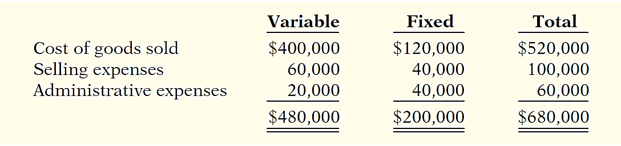
CVP Income Statement Revisited
Assume that Vargo Video reaches its target net income of $120,000. The following information is obtained on the $680,000 of costs that were incurred in June to produce and sell 1,600 units.
Illustration 22-34
Assumed cost and
expense data
LO 6

Slide 81
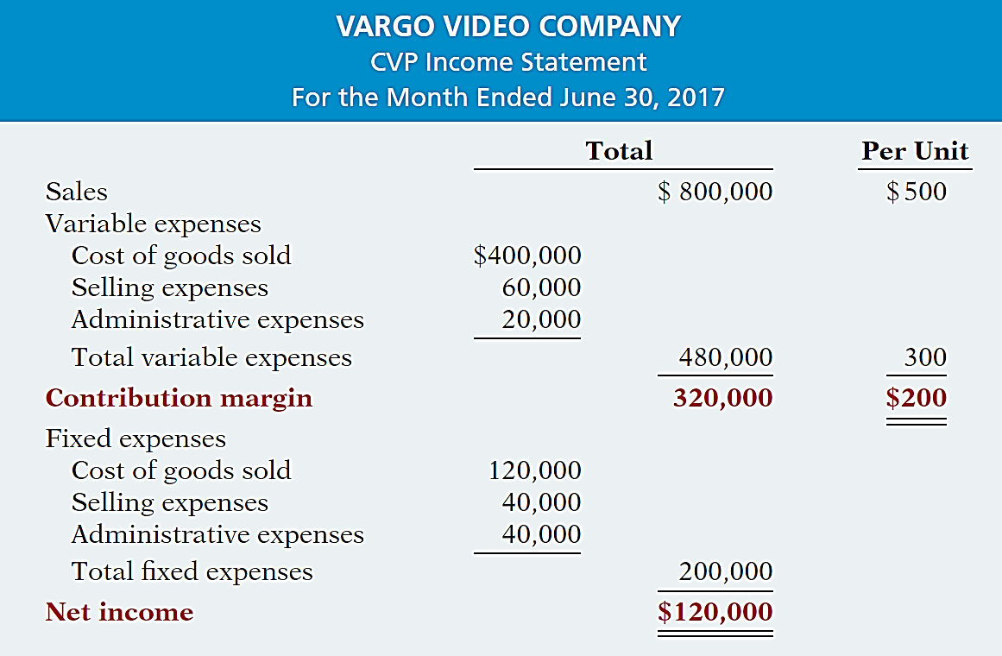
Illustration 22-35
Detailed CVP income statement
LO 6

Slide 82
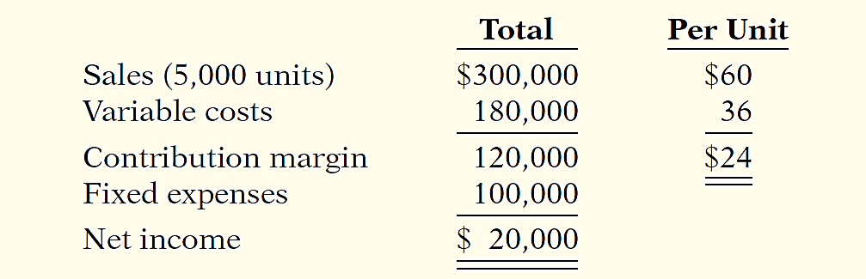
DO IT!
6
CVP Analysis
Krisanne Company reports the following operating results for the month of June 2017.
To increase net income, management is considering reducing the selling price by 10%, with no changes to unit variable costs or fixed costs. Management is confident that this change will increase unit sales by 25%. Using the contribution margin technique, compute the break-even point in units and dollars and margin of safety in dollars (a) assuming no changes to sales price or costs, and (b) assuming changes to sales price and volume as described above. (c) Comment on your findings.
LO 6

Slide 83
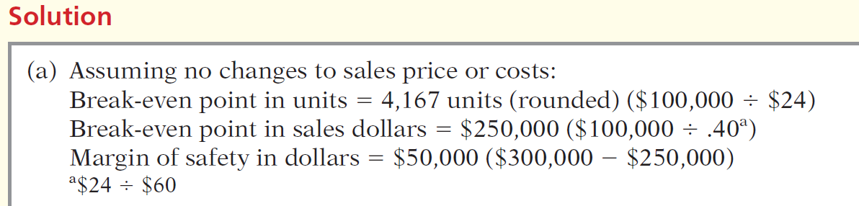
DO IT!
6
CVP Analysis
Krisanne Company reports the following operating results for the month of June 2017.
LO 6

Slide 84
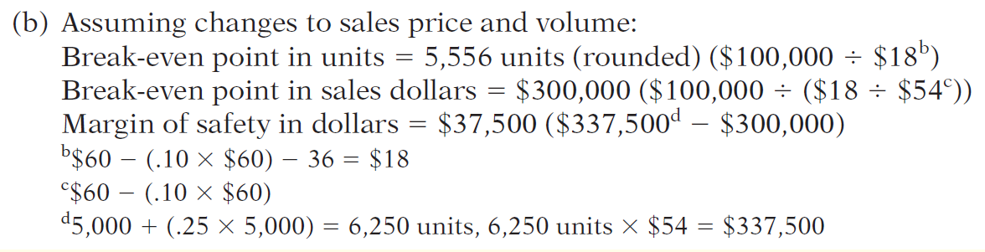
DO IT!
6
CVP Analysis
Krisanne Company reports the following operating results for the month of June 2017.
LO 6

Slide 85
DO IT!
6
CVP Analysis
Krisanne Company reports the following operating results for the month of June 2017.
(c) The increase in the break-even point and the decrease in the margin of safety indicate that management should not implement the proposed change. The increase in sales volume will result in contribution margin of $112,500 (6,250 x $18), which is $7,500 less than the current amount.
LO 6

Slide 86
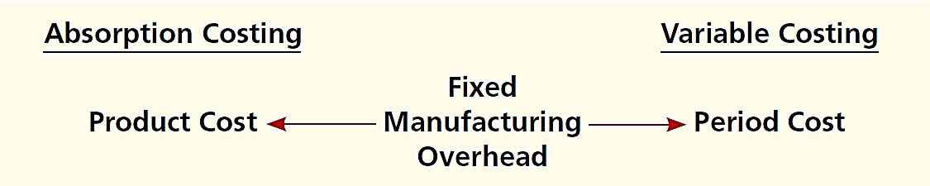
LEARNING
OBJECTIVE
APPENDIX 22A: Explain the difference between absorption costing and variable costing.
7
Under variable costing only direct materials, direct labor, and variable manufacturing overhead costs are considered product costs. Companies recognize fixed manufacturing overhead costs as period costs (expenses) when incurred.
Illustration 22A-1
Difference between absorption
costing and variable costing
LO 7

Slide 87
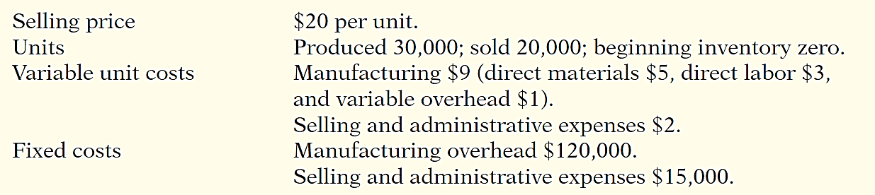
CVP Income Statement Revisited
Illustration: Assume that Premium Products Corporation manufactures a polyurethane sealant, called Fix-It, for car windshields. Relevant data for Fix-It in January 2017, the first month of production, are as follows.
Illustration 22A-2
Sealant sales and cost data for
Premium Products Corporation
LO 7

Slide 88
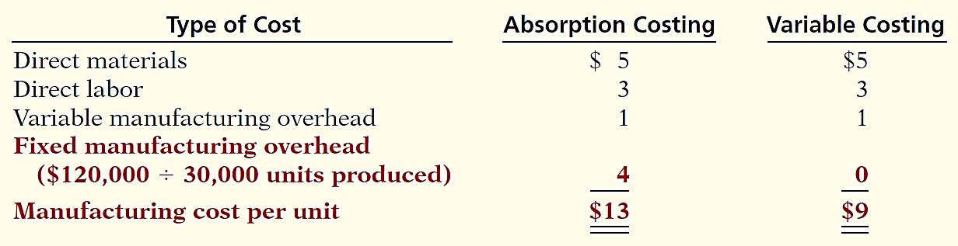
CVP Income Statement Revisited
Illustration: The per unit production cost of Fix-It under each costing approach is:
Illustration 22A-3
Computation of per unit
manufacturing cost
*
Based on these data, each unit sold and each unit remaining in inventory is costed under absorption costing at $13 and under variable costing at $9.
LO 7

Slide 89
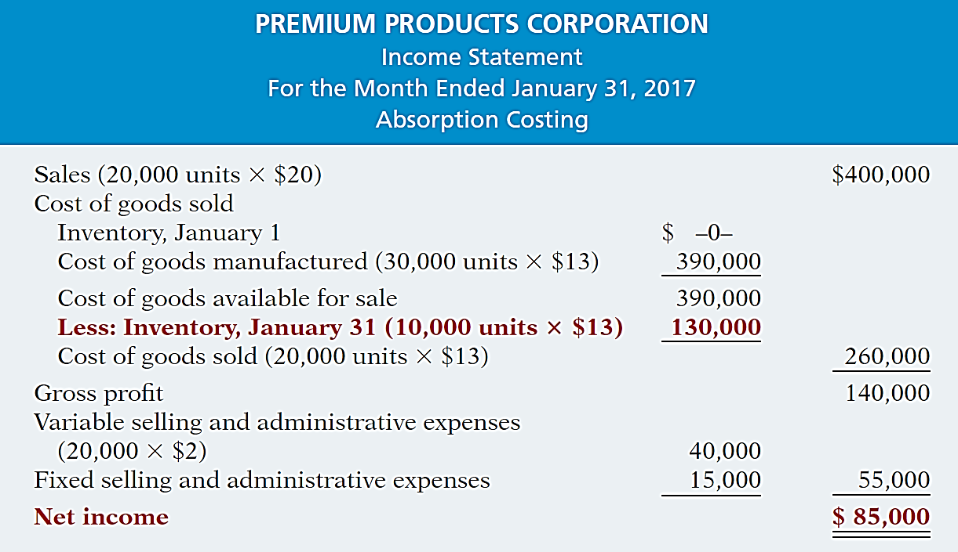
Illustration 22A-4
Absorption costing income statement
Helpful Hint
The income statement format in Illustration 22A-4
is the same as that used under generally accepted
accounting principles.
LO 7

Slide 90
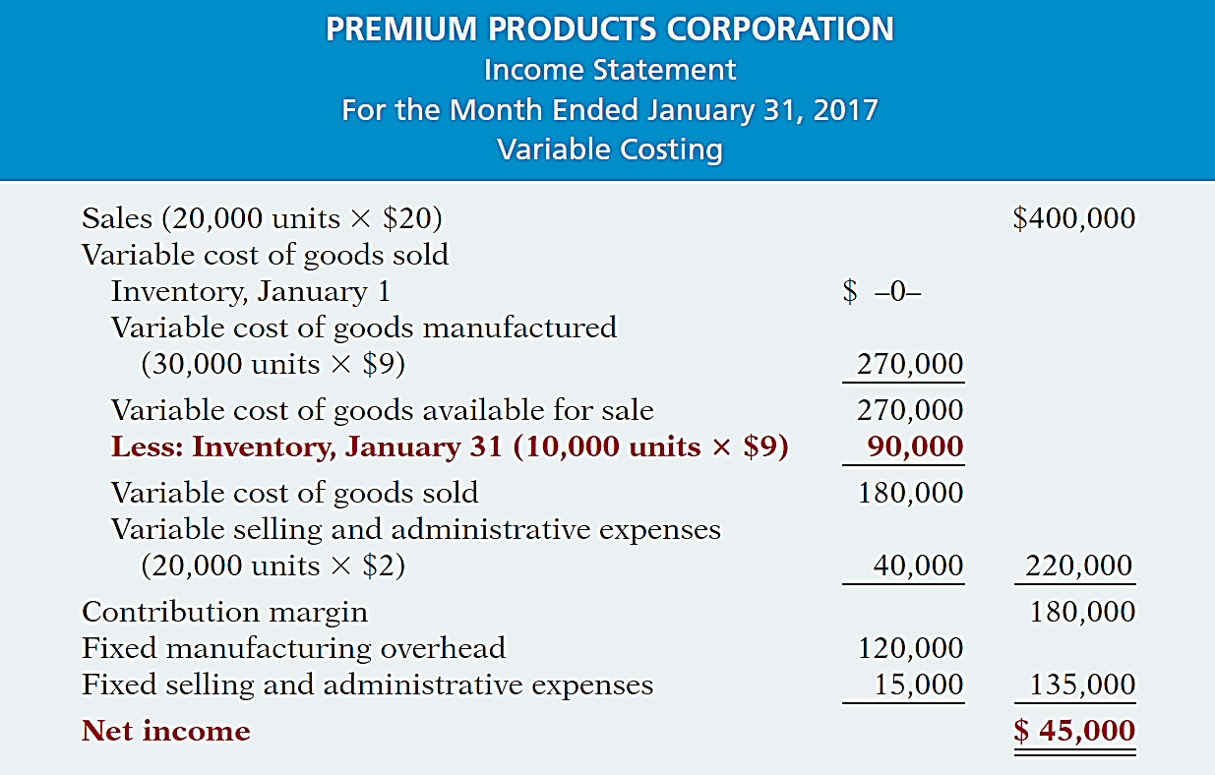
Illustration 22A-5
Variable costing income statement
Helpful Hint
Note the difference in the computation of the ending inventory: $9 per unit here, $13 per unit in Illustration 22A-4.
LO 7

Slide 91
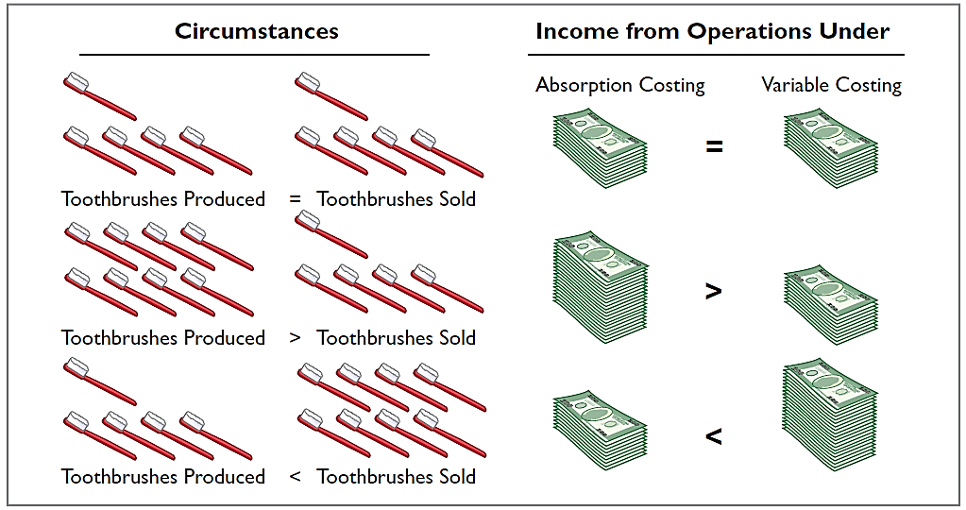
Absorption and Variable Costing
Illustration 22A-6
Summary of income effects under absorption costing and variable costing
LO 7

Slide 92
Rationale for Variable Costing
The purpose of fixed manufacturing costs is to have productive facilities available for use.
The use of variable costing is acceptable only for internal use by management.
LO 7

Slide 93
Copyright
“Copyright © 2015 John Wiley & Sons, Inc. All rights reserved. Reproduction or translation of this work beyond that permitted in Section 117 of the 1976 United States Copyright Act without the express written permission of the copyright owner is unlawful. Request for further information should be addressed to the Permissions Department, John Wiley & Sons, Inc. The purchaser may make back-up copies for his/her own use only and not for distribution or resale. The Publisher assumes no responsibility for errors, omissions, or damages, caused by the use of these programs or from the use of the information contained herein.”

